Slide 1
TERMS AND CONDITIONS
These PowerPoint slides are a tool for lecturers, and as such:
YOU MAY add content to the slides, delete content from the slides, print out the slides, and save the slides onto your computer or server.
YOU MAY NOT resell, reproduce or redistribute the content in any form whatsoever, without prior written permission from the copyright holder.
© Troupant Publishers (Pty) Ltd, 2016
Selected images used under licence from Shutterstock.com

Slide 2
Engineering Systems
NQF Level 2

Slide 3
Pneumatic systems
Module 5

Slide 4
Pneumatic systems and their components
Unit 5.1

Slide 5
Pneumatic systems
The branch of science and technology that deals with the study and application of the use of pressurised gas to effect mechanical motion.
Pneumatics uses a compressible gas, usually air.

Slide 6
Introduction
Figure 5.1 A pneumatic wrench

Slide 7
Air supply
Air supply at the required pressure, that is dry and clean is needed for effective performance of a pneumatic system.
A compressor is used to generate compressed air.

Slide 8
VIDEO: Compressor

Slide 9
Air supply
Use of compressed air:
To determine the status of processors (sensors).
Information processing (processors).
Switching of actuators.
Performing work (actuators).

Slide 10
Components of a pneumatic system
Compressor.
Air receiver or reservoir.
Air distribution system consisting of:
Main line.
Ring lines.
Air pressure regulators.
Filters.
Lubricators.
Valves.

Slide 11
Components of a pneumatic system
Air service unit consisting of:
Air filter.
Pressure regulator.
Lubricator.
Valves that perform various functions.
Actuators.
Visual indicating devices.
Pneumatic air lines.

Slide 12
Compressor
All compressors have the same function, namely to compress air.
The compressor piston draws air through a valve from the atmosphere at atmospheric pressure. Air is compressed.

Slide 13
Compressor
Figure 5.2 Parts of a compressor

Slide 14
Air receiver
The function is to provide constant air pressure in a pneumatic system.
The large surface area cools the air and separates moisture in the air, which is removed as water through a drain plug.

Slide 15
Air distribution system
Air lines consist of a main line and ring lines.
Air pressure regulators are fitted in the air lines to regulate line pressure.
Filters and lubricators are also fitted.

Slide 16
VIDEO: Drier

Slide 17
Air distribution system
Figure 5.3 A compressed air distribution system

Slide 18
Air distribution system
Pneumatic air lines include:
Galvanised iron pipes.
Copper pipes.
Rubber hoses.
Plastic and nylon hoses.
Reinforced rubber hoses.
Flexible material hoses.

Slide 19
Air service unit
An air service unit prepares the air for use after it has been compressed.
Air service unit consists of the following:
Air filter.
Regulator.
Lubricator.

Slide 20
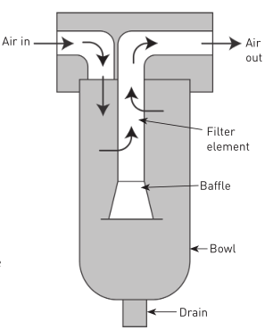
Air service unit
Air filter
Figure 5.4 An air filter

Slide 21
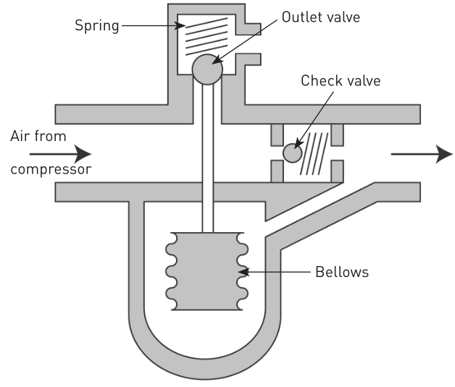
Air service unit
Pressure
regulator
Figure 5.5 A typical pressure regulator

Slide 22
Valves
The function of valves is to control the pressure or flow rate.

Slide 23
Valves
Categories of valves:
Directional control valves.
Non-return valves.
Flow control valves.
Pressure control valves.
Shut-off valves.
Emergency stop valves.

Slide 24
Valves
Directional control valves
Number of ports or openings (ways).
Number of positions.
Methods of actuation of the valve.
Methods of return actuation.

Slide 25
Directional control valves
Table 5.1 Ports and positions (ways)

Slide 26
Non-return valves
Valves
Non-return valves allow air to flow through the device in one direction, while blocking the air flow in the opposite direction.

Slide 27
Flow control valves
Valves
Figure 5.6 A flow control valve

Slide 28
Valves
Pressure control valves
Pressure relief valves.
Pressure regulating valves.
Pressure sequence valve.

Slide 29
Valves
Pressure relief valves
Used to ensure that the receiver pressure is limited for safety and that the supply pressure to the system is set to the correct pressure.

Slide 30
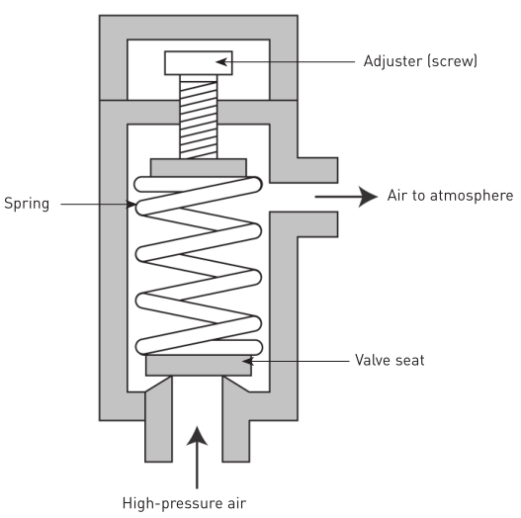
Valves
Pressure relief valves
Figure 5.7 A pressure relief valve

Slide 31
VIDEO: Pressure vessel

Slide 32
Valves
Pressure regulating valves
Keep the pressure constant, regardless of any pressure fluctuations in the system.

Slide 33
Valves
Pressure sequence valves
Used if a pressure-dependent signal is required for the operation of a control system.

Slide 34
Valves
Shut-off valves
Pneumatic systems should always be fitted with some form of isolation.
This allows for maintenance and servicing to take place while the main system is still in use and pressurised.

Slide 35
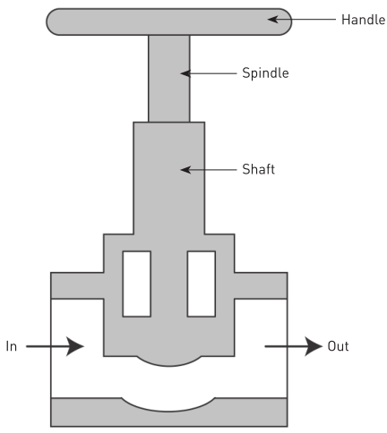
Valves
Shut-off valves
Figure 5.8 A stop cock

Slide 36
Valves
Emergency stop valves
Two types:
A push-operated latching button which requires a twist action to release.
A push-operated valve which requires a key to release.

Slide 37
Actuators
Actuators convert energy in the form of compressed air into linear or rotary motion.
A pneumatic motor converts pneumatic energy into mechanical rotary motion.

Slide 38
Actuators
Figure 5.9 A single-acting cylinder

Slide 39
Actuators
Pneumatic motor characteristics:
Smooth regulation of speed and torque.
Small size (weight).
Overload safe.
Explosion proof.
Requires less maintenance.
Insensitive to dust, water, heat and cold.
Direction of rotation easily reversed.

Slide 40
Visual indicating devices
They represent the operating status of a pneumatic system visually.
Serve as a primary diagnostic aid.
Include counters, pressure gauges, timers and optical indicators.

Slide 41
Visual indicating devices
Figure 5.11 A pressure gauge

Slide 42
Control circuits for cylinders
There are two types of control circuits:
For single-acting cylinders.
For double-acting cylinders.

Slide 43
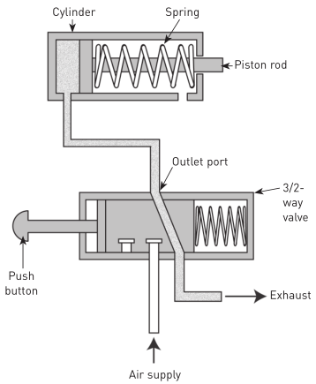
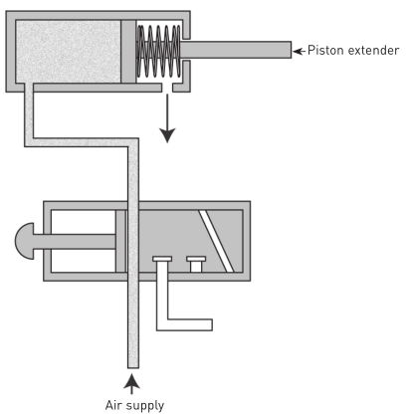
Control circuit for a single-acting cylinder
Figure 5.12 Initial position
Figure 5.13 Activating the push button

Slide 44
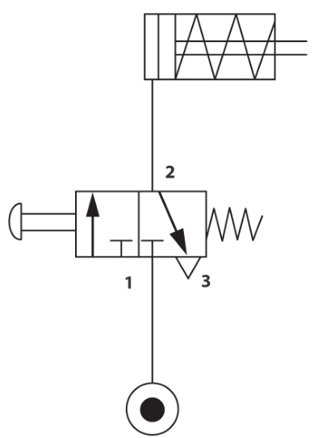
Control circuit for a single-acting cylinder
Figure 5.14 Circuit diagram for a single-acting cylinder

Slide 45
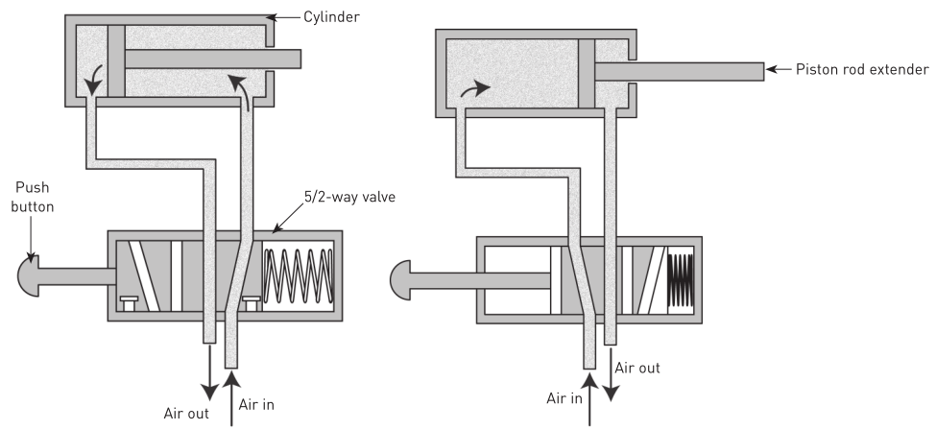
Control circuit for a double-acting cylinder
Figure 5.15 Initial position
Figure 5.16 Activating the push button

Slide 46
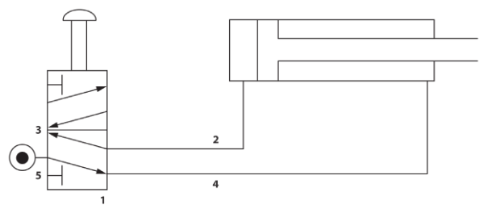
Control circuit for a double-acting cylinder
Figure 5.17 Circuit diagram for a double-acting cylinder

Slide 47
Pneumatic systems
Advantages and disadvantages of pneumatic systems
Advantages | Disadvantages
Air can easily be transported in pipelines, even over long distances. | Leaks are difficult to trace.
Air is freely available all the time. | Pneumatic systems are not suitable for large equipment.
Most components do not require lubrication. | Air carries moisture which condenses and poses a corrosion, contamination and freezing threat to the internal workings of the components and the pipework.
The operating components are of simple construction.
Compressed air is a fast-working medium. This enables high working speeds to be attained. | High-pressure air is ‘explosive’ by nature.
Compressed air can be stored in a reservoir and used as required.

Slide 48
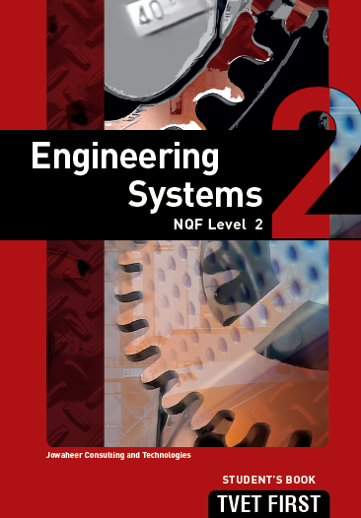
Summative assessment
Test your knowledge of this section by completing the Summative assessment (page 86 of your Student’s Book)

